Slide 1
Introduction to Machine Learning
VIJAY JAISANKAR

Slide 2
Before we start…
Official Github Repository:
https://github.com/vijay-jaisankar/ML_TA_IIITB_2022
Official communications:
Slack and LMS
Find Good Resources?
Make a PR! https://github.com/zense/helpful-resources

Slide 3
FAQs
Do I need a fancy computer? No.
Do I need to know programming? Yes.
Do I need to know a lot of maths? It’s complicated.

Slide 4

Lecture Plan
Some gradient descent.
Honest advice and tools to get you started, too!

Slide 5
So, what actually is ML?
What is AI?
Are they the same?
Is it a scam?
What is life?

Slide 6
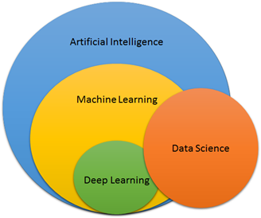
Source: https://medium.com/@dilip.rajani/comparing-ds-ml-dl-and-ai-65627109e67a

Slide 7
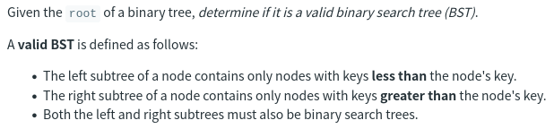
Introductory Example (Also: PTSD)
How would you approach this problem?
Are there solid and defined rules?

Slide 8
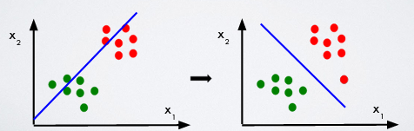
What rules will you define?
What rules can we define for this problem? Where do we stop?
What test-cases do we check our solution’s correctness with?

Slide 9
What if?
What if someone or something can analyse the data and get the rules for you? Analogy: Leetcode Discuss

Slide 10
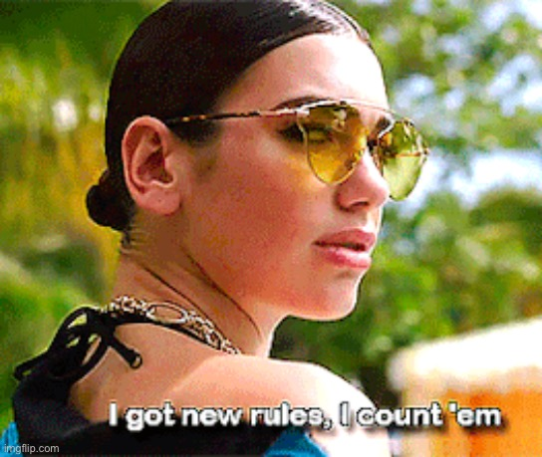
Machine Learning
ML consists of a set of algorithms
that allow software applications to become more accurate at
predicting outcomes without being explicitly programmed
to do so.

Slide 11
Basic Components
Tasks
Models
Features
Datasets

Slide 12
???

Slide 13
A little more detail
Tasks == Problems you wish to apply Machine Learning on; clear declaration and definition of inputs and outputs
Models == Algorithms run on data that generate insights
Features == Filtered and Processed Inputs
Datasets == “Raw” Data

Slide 14
Pandas, Numpy, Matplotlib, Kaggle, Colab

Slide 15
Introduction
Pandas - Dataset operations
Numpy - Mathematical functions
Matplotlib - Plots and Charts
Kaggle - Hosts Datasets, Notebooks, and Contests
Colab - Interface Google Drive with Jupyter

Slide 16
Jupyter Notebooks
Interactive Python
Local server on browser
VSCode Plugin
Kaggle/Colab

Slide 17
Let’s get our hands dirty!

